Slide 1
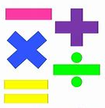

Maths Workshop
Year 1 and 2.
Friday 24th January 2020.

Slide 2
Welcome…
Thank you for taking the time to come this morning.
We hope you found it interesting and useful watching your child in part of their Maths lesson.

Slide 3
What we aim to cover this morning.
Sharing the Maths curriculum for Year 1 and 2.
Looking at the main four key operations-
Addition, Subtraction, Multiplication and Division.
Looking at strategies we use in school to teach the children.
Sharing different ways you can help to support your child at home.

Slide 4
Place Value- Number.
Counting, reading and writing numbers to 100.
Counting forwards and backwards.
Correct number formation.
Counting in multiples of 2, 5 and 10.
Counting in steps of 2, 3, 5 and 10- Year 2.
2s- 0, 2, 4, 6, 8, ___,
3s- 0, 3, 6, 9, 12, ___,
5s- 0, 5, 10, 15, 20, ___,
10s-0, 10, 20, 30, 40, ___,
Recognising and counting in Odd and Even numbers.
Odd numbers end in: 1, 3, 5, 7, 9.
Even numbers end in: 0, 2, 4, 6, 8.

Slide 5
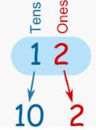
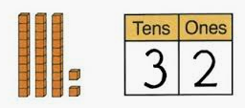
Place Value- Number.
One more and one less than a given number.
Recognising tens and ones- two-digit numbers.
Compare and order numbers- 22, 10, 18, 29
Smallest to largest- 10, 18, 22, 29.
Largest to smallest- 29, 22, 18, 10.

Slide 6
Ways to help at home…
Look for numbers in the environment.
Number hunt around the house.
Counting with your children- singing counting songs.
Counting out objects- toys, cutlery, plates.
Writing numbers on a piece of paper- can they share what they know?- one more, one less, odd, even.
On paper, write +1, -1. +10, -10.
Lego- number stickers on- ordering.
Playing snakes and ladders.
Odd and even paper chains.

Slide 7
National Curriculum.
Pupils in Year 1 should be taught to:
Read and write addition and subtraction number sentences.
Use number bonds up to 20.
Add and subtract one-digit and two-digit numbers to 20, including zero.
Solve one-step problems.

Slide 8
National Curriculum.
Pupils in Year 2 should be taught to:
Solve problems with addition and subtraction.
Use mental and written methods.
Use number facts to 20 and find related facts to 100.
Add and subtract numbers in different ways.
Use inverse relationships. E.g. addition and subtraction.

Slide 9
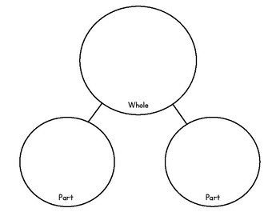



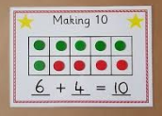
Number bonds.
Part-Part whole.
10
Numicon.
+
Ten Frame.

Slide 10

Addition
Vocabulary:
-Add
-Plus
-Count on
-Total
-Altogether
-Sum
-More than
-Greater
-Increase

Slide 11
Different strategies to Add-
Use fingers/ objects.
Draw pictures.
Use a 100 square.
Use number lines.
Part-part whole model.
Numicon.
Using tens and ones.

Slide 12



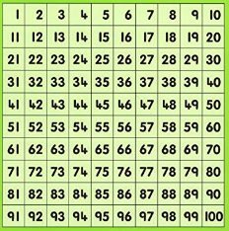
Different strategies to Add.
12 + 4 =
Use your fingers/objects/ drawing.
Use 100 square or number line.
+
12

Slide 13


Different strategies to Add.
23 + 12=
Using tens and ones knowledge.
23 + 12 =

Slide 14

Subtraction
Vocabulary:
-Subtract
-Take-away
-Minus
-Count back
-Fewer
-Less than
-Decrease

Slide 15
Different strategies to
Subtract-
Use fingers/ objects.
Use a 100 square.
Use number lines.
Draw pictures.
Using tens and ones.

Slide 16
Different strategies to subtract.
12 - 4 =
Use 100 square or number line.
Use your fingers/objects/ drawing.
12

Slide 17
Different strategies to Subtract.
23 - 12=
Using tens and ones knowledge.
23 - 12 =
12
11
13

Slide 18
Ways to help at home…
Lego- adding two amounts together.
Play-Doh.
Roll two dice and add or subtract them.
Dominoes- adding both sides of the domino.
Show them a number sentence- What else do they know?
E.g. 5 + 3 = 8 , 15 + 3 =18, 25+ 3 = 28
Adding items at dinner-
If I added the number of chips you have to the number I have, how many chips are there altogether?
Straws.

Slide 19
National Curriculum.
Pupils in Year 1 should be taught to:
Solve one-step problems.
Pupils in Year 2 should be taught to:
Use multiplication and division facts for the 2, 5 and 10 multiplication tables, including recognising odd and even numbers.
Write multiplication and division number sentences.
Solve problems involving more than one step.

Slide 20

Multiplication
Vocabulary:
-Multiply
-Times
-Repeated addition
-Lots of
-Groups of
-Product
-Multiplied by

Slide 21
Different strategies to Multiply.
Using objects.
Drawing pictures.
Use knowledge of counting in 2s, 3s, 5s and 10s.

Slide 22
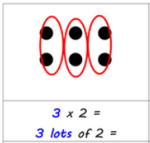

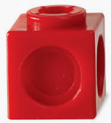
Different strategies to Multiply.
2 + 2 + 2 =

Slide 23
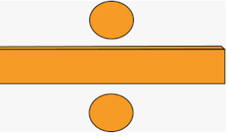
Division
Vocabulary:
-Divide.
-Share.
-Shared by.
-Shared equally.
-Groups of.

Slide 24
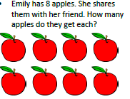
Different strategies to Divide.
8 ÷ 2 =

Slide 25
Ways to help at home…
Sharing out teddies/toys.
Can you give each of us 2 sweets each?
Counting coins- 3 x 5p- counting in 5s.

Slide 26

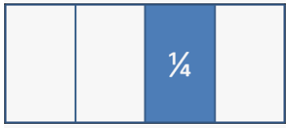
Fractions.
Half and quarter of shapes
–Divide the shapes in to equal parts.
Half and quarter of numbers or objects
-Draw pictures to find the halves and quarters.
12

Slide 27
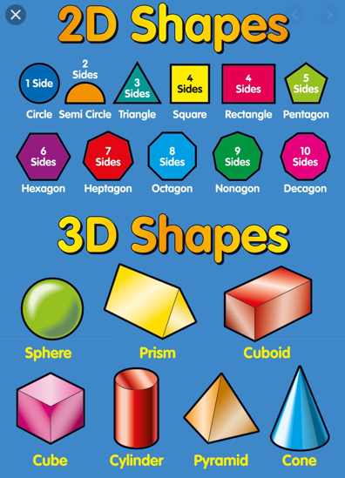
Shape.
Know the names of 2-D and 3-D shapes.
Describe their properties.

Slide 28
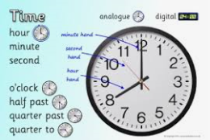
Time.
Year 1
Year 2
Reading the time on clocks for:
-O’clock.
-Half past.
Reading the time on clocks for:
-O’clock.
-Half past.
-Quarter Past.
-Quarter to.
-5 minute intervals.

Slide 29
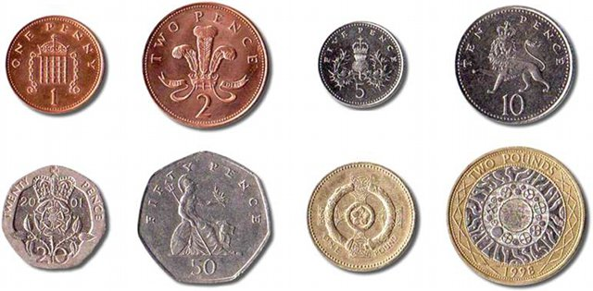
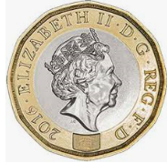
Money.
Use coins to make totals and give out change.
1p coins
2p coins
5p
10p coins
20p
Mixed coins

Slide 30



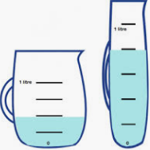
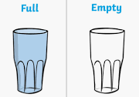
Measure.
Length- cm and m
-Long, longer and longest.
-Short, shorter and shortest.
Height- cm and m
-Tall, taller and tallest.
-Short, shorter and shortest.
Weight- g and kg
-Heavy, heavier and heaviest.
-Light, lighter and lightest.
Capacity- ml and l.
-Full, half full, empty.

Slide 31

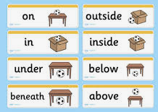
Direction and Position.
Direction
Forwards, Backwards.
Right, Left.
Turn
Half, quarter, three quarter turns using clock face.
Position
Over, under, next to, behind.

Slide 32
Things to remember…
The more you practise with your children the more exposure they will receive.
-Creating real-life links for the children.
Maths focus- displayed in classroom windows.
School website- Calculation policy and useful websites.
Maths Homework- set weekly.
Always ask your child’s class teacher if you are unsure.
Information leaflet and resources supplied today.

Slide 33
Thank you very much for coming.

